Slide 1
UNITED NATIONS GLOBAL GEODETIC
CENTRE OF EXCELLENCE
MODERNISING GEOSPATIAL REFERENCE SYSTEM
CAPACITY DEVELOPMENT WORKSHOP
Tools for standardisation: Data formats and metadata
Nicholas Brown
Head of Office, UN-GGCE
Day 2, Session 3 [2_3_2]
HOW
Acknowledgements: Ivana Ivánová (AUS); Liubov Poshyvailo-Strube (UN-GGCE)

Slide 2
Overview
Introduction and motivation
Challenges faced by public users of geodetic data
Ideal scenario of standardized infrastructure
GeodesyML
Summary and conclusions
The image is created by Liubov Poshyvailo-Strube with Microsoft Designer, https://designer.microsoft.com/

Slide 3
Background
Geodetic services (like IGS) provide data for an increasingly diverse community
In the past, the user community was predominantly those from the geodesy and surveying industry, governments and academia
More recently there has been widespread uptake across society of accurate and reliable positioning information in new markets

Slide 4
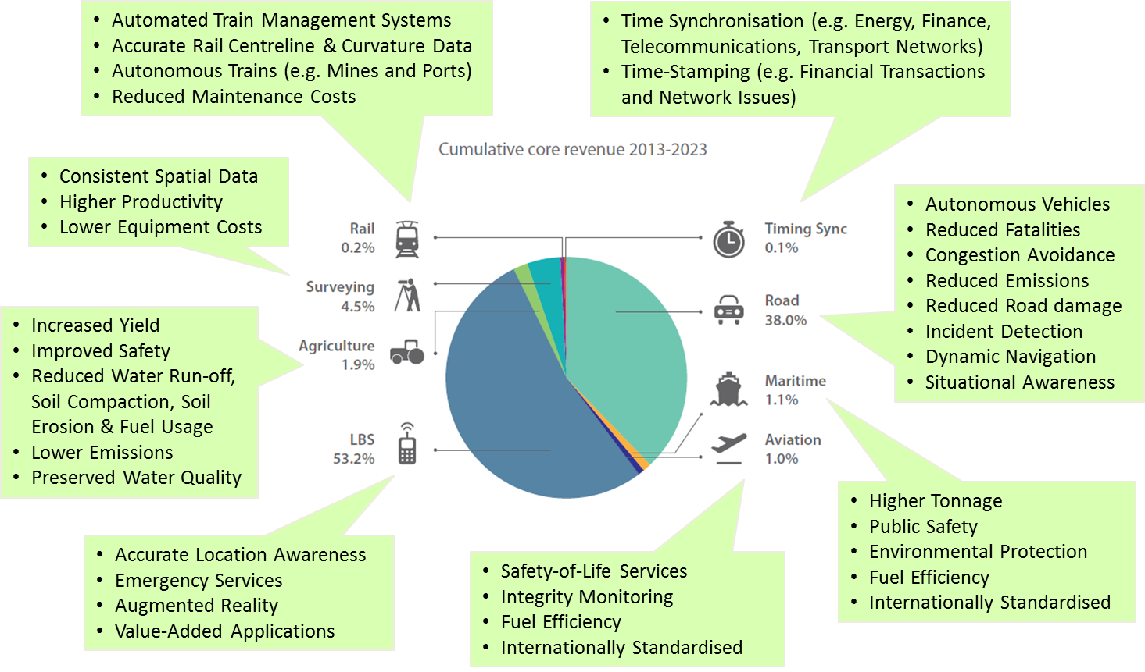
Changing world …
Growing need for real-time data and interoperability

Slide 5
OUTLINE
Introduction
Challenges faced by public users of geodetic data
Ideal scenario of standardized infrastructure
GeodesyML for metadata standardization
Summary and conclusions

Slide 6
What do users expect from geodetic data?
Users want to determine whether data fits their purpose
Users aren’t native geodesists but have expectations on the quality of geodetic data, and they learned to use standard geodetic language for that.

Slide 7
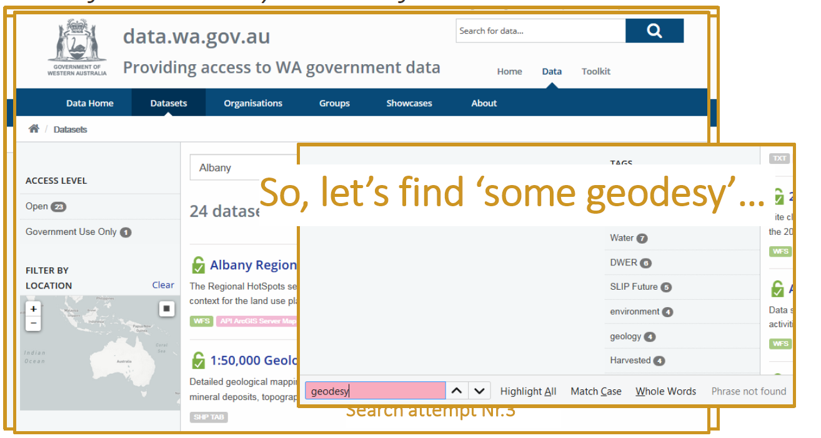
What are users getting today?
I want GNSS data from Albany station from 6 June 2019, where are the data?

Slide 8
What are the data?

Slide 9
What are the data?

Slide 10
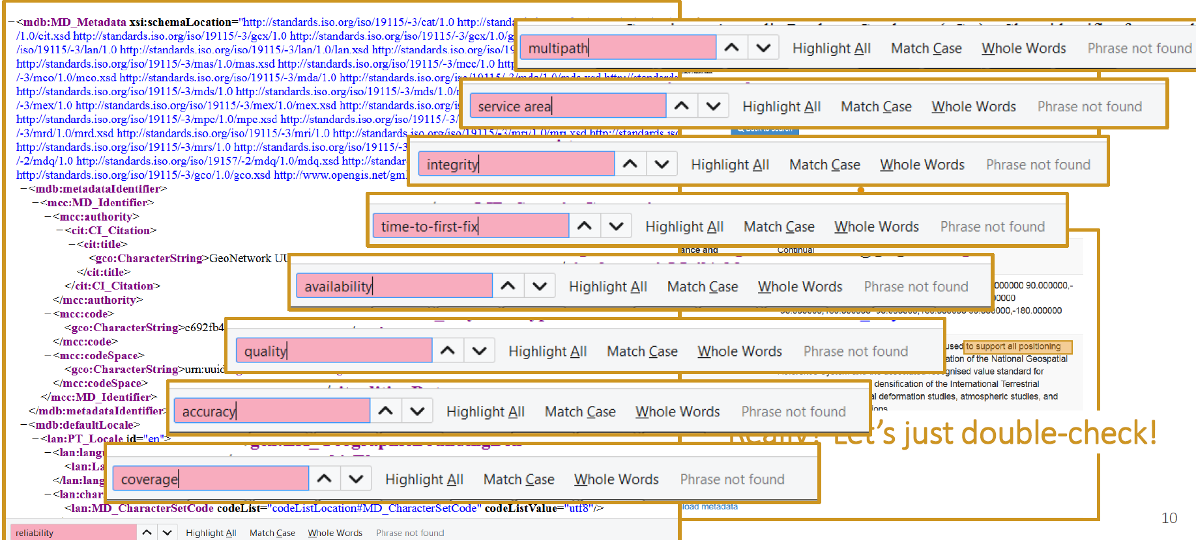
But how fit for purpose is the data?

Slide 11
User requirements
To satisfy the user demands, our geodetic data and the associated metadata need to be standardized, discoverable, interoperable and authoritative
Current standards for delivering geodetic data will not adequately serve the needs of new (non-geodetic) users, who will emerge on account of the rapid growth in precise positioning services.
Broad, multi-domain, standards are important for combining geodetic data with data from other domains.

Slide 12
The need for modern standards
Well known standards are available for encoding fundamental geodetic data (e.g., SINEX, RINEX, ANTEX, SP3 etc.)
But not all users know where or how to look for information (e.g., coordinates in a SINEX file) to fit their requirements
Users need to be able to query, access and retrieve data in near real-time without knowing how (e.g., format) or where (e.g., data center) the information is stored
No international standard is available which makes geodetic data and metadata openly accessible, machine-to-machine readable and interoperable for these emerging markets
There is a need to modernize standards to encode and exchange geodetic data and metadata

Slide 13
Standards
Standards

Slide 14
OUTLINE
Introduction
Challenges faced by public users of geodetic data
Ideal scenario of standardized infrastructure
GeodesyML
Summary and conclusions

Slide 15
Imagine …
IGS Analysis Centers
IGS Regional
Data Centers
IGS Analysis Centers
IGS Analysis Centers
IGS Data Centers
IGS Analysis Centers
IGS Analysis Centers
IGS Analysis Centers
IGS Analysis Center Coordinator
IGS Analysis Centers
IGS Analysis Center Coordinator
Global Data Centers

Slide 16
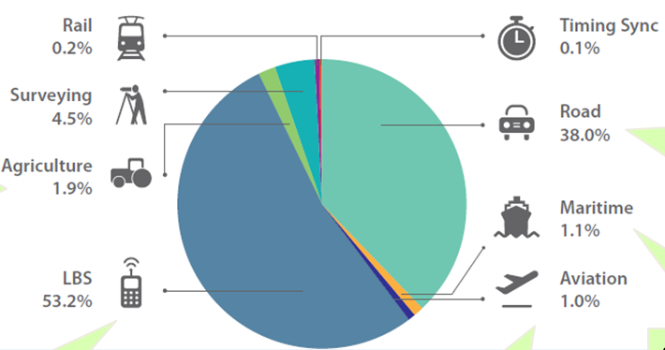
Reference Frame
IGS
ILRS
IVS
IDS
Discover Share Combine Display
+ government
+ academia

Slide 17
OUTLINE
Introduction
Challenges faced by public users of geodetic data
Ideal scenario of standardized infrastructure
GeodesyML
Summary and conclusions

Slide 18
GeodesyML is a solution for efficient positioning data (and metadata) delivery
GeodesyML

Slide 19
Extending Geography Markup Language (GML)
GML provides a rich set of primitive objects like, geometry, coordinate reference system, time etc.
But not detailed / specific standards. For example, GML can not be used to describe everything about a GNSS, VLBI, SLR, DORIS sites.
The geodetic standard needs objects like antenna, receiver, cable, adjustments etc.
GML Application Schemas extend GML to meet the needs of a specific community of interest (e.g. SensorML, GeoSciML, GeodesyML)

Slide 20
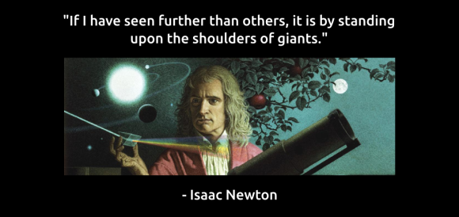
GML Application Schemas
Coordinate Reference System, Time, Unit of measures
Many proprietary and open-source software vendors and database technology providers support GML

Slide 21
GeodesyML
GeodesyML enables machine-readable access via the internet, i.e. for more than dedicated (geodetic) equipment.
Australia and New Zealand have created the Geodesy Markup Language (GeodesyML)
GeodesyML is a standard way of describing (encoding) and sharing geodetic data and metadata in XML format
GeodesyML harmonizes language of geodesy – allows mapping of geodetic database into a common language to exchange data with others.
GeodesyML is proposed Application Schema of the Geography Markup Language (ISO Standard)

Slide 22
Standards
International Organization for Standardization
ISO 19136:2007
+ GeodesyML (proposed GML Application Schema)

Slide 23
Who is GeodesyML for?
GeodesyML
CDDIS
SCRIPPS
CODE
Data Providers
BKG
Web service (+GeodesyML)
GA
GeodesyML
Data Consumers
DEWLP
BERN
IGS
ILRS
IVS
…

Slide 24
GeodesyML
Standard way to encode and exchange:
GNSS related data and metadata
Terrestrial observations
Reference frames
Adjustments
Measurements
Site
Quality
Local Ties
Could extend GeodesyML for the other techniques SLR, VLBI, DORIS.

Slide 25
GeodesyML
https://github.com/International-GNSS-Service/GeodesyML
The current version is GeodesyML v0.4 (BETA)
GeodesyML helps creating GNSS data and the associated metadata standardised, discoverable, and interoperable
GeodesyML is being used within the IGS to maintain site log information
GeodesyML is used in Sweden to facilitate the bulk transfer of IGS site log updates to the IGS.
Everyone is welcome to use and contribute to GeodesyML

Slide 26
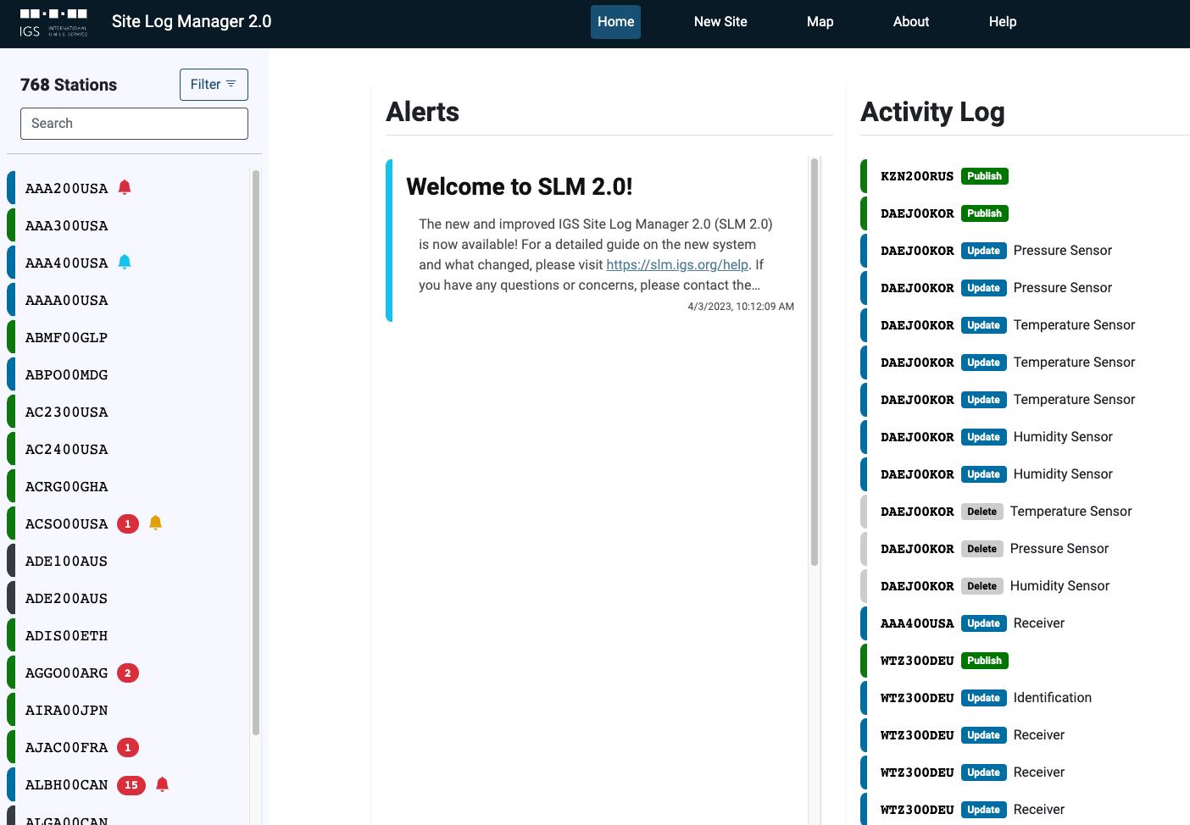
IGS Site Log Manager
https://github.com/International-GNSS-Service/SLM
The Site Log Manager (SLM) is a web framework for managing GNSS ground station meta data. SLM is maintained by the International GNSS Service and is freely licensed for general use under the MIT License. The SLM is implemented in Python and JavaScript using the Django web framework.

Slide 27
Additional resources
Bradke, M.: Update from the GeodesyML Working Group, International GNSS Service (IGS) Workshop 2022 – Splinter Session. Retrieved January 20, 2025, from https://files.igs.org/pub/resource/pubs/workshop/2022/IGSWS2022_S10_04_Bradke.pdf.
Donnelly, N., Fraser, R.W., Haasdyk, J., and Tarbit, S.: GeodesyML – A GML Application Schema for Geodetic Data Transfer in Australia and New Zealand, 2013. Retrieved January 28, 2025, from https://api.semanticscholar.org/CorpusID:130458997.
Intergovernmental Committee on Surveying and Mapping (ICSM): The Use of GeodesyML to Encode IGS Site Log Data. Retrieved January 15, 2025, from https://lists.igs.org/pipermail/igs-dcwg/attachments/20150604/e32d991f/attachment.pdf
International GNSS Service. GeodesyML [Software]. GitHub. Available from https://github.com/International-GNSS-Service/GeodesyML.
Open Geospatial Consortium: Geography Markup Language (GML). Retrieved January 25, 2025, from https://www.ogc.org/publications/standard/gml/.

Slide 28
Q & A

